Slide 1
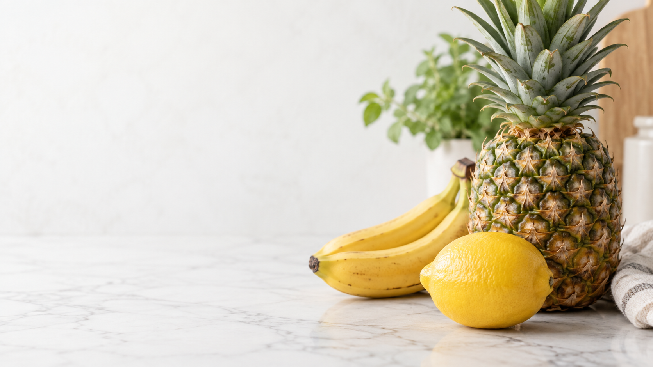
Tropical fruits
[Name and course]
Notes:
Title background added; set native image transparency to your chosen semi-transparent level in PowerPoint. Source: https://learning.noroff.no/mod/book/view.php?id=22907&chapterid=81645. Apply Facet, named title colour and required effects in PowerPoint.

Slide 2
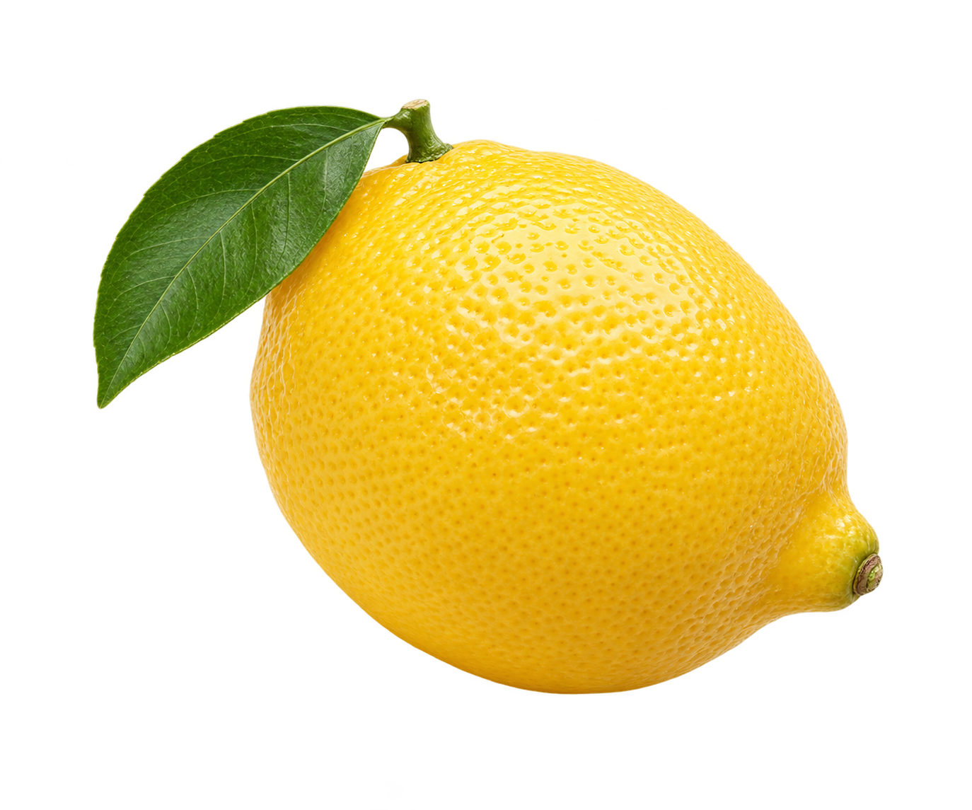
Lemon
Latin name: Citrus lemon
Size: 5–8 cm
Weight: up to 60 g
Static preview: replace with a native lemon 3D model for Task 4.3.
Notes:
Supplied exercise facts: https://learning.noroff.no/mod/book/view.php?id=22907&chapterid=81645. Preserve the given botanical wording; it is not an independent taxonomy claim. Apply Facet and Dark Green, Accent 2, Darker 50% title colour. Apply Morph to all slides. This scaffold has no actual media, animations or theme applied. Required object effect: Grow & Turn. Banana background removal and pineapple sizing require native editing.
Media added: lemon-illustration.png. Generated educational asset. This is a static PNG, not a native 3D model; replace it before applying the required model animation.

Slide 3
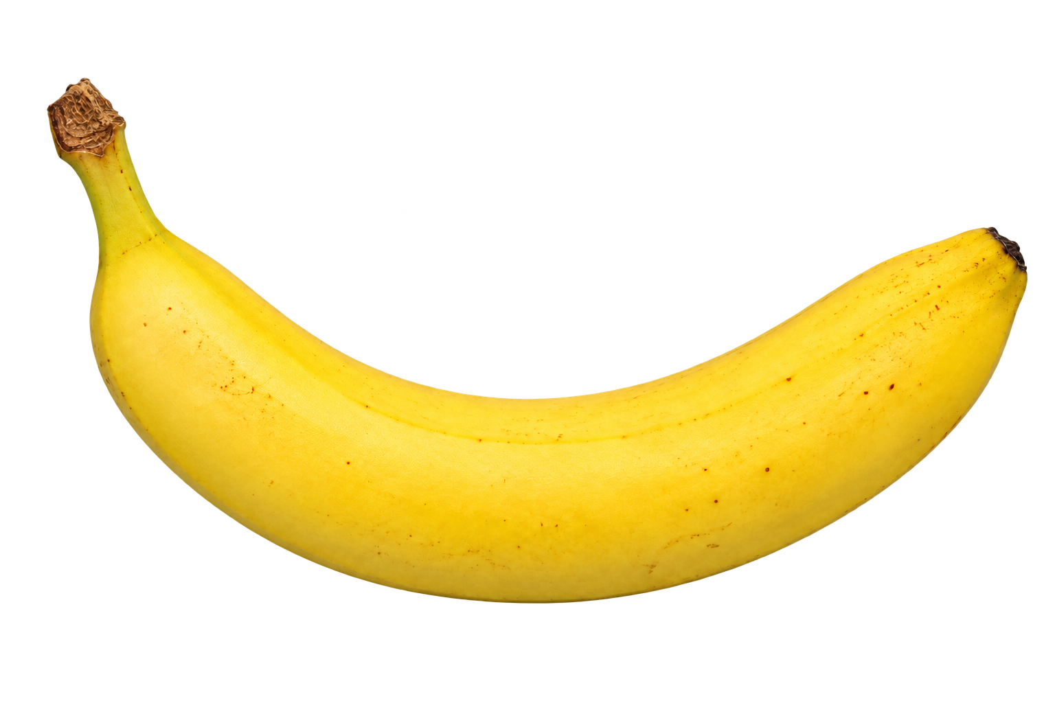
Banana
Latin name: Musa
Length: 15 cm
Weight: approximately 120 g
Notes:
Supplied exercise facts: https://learning.noroff.no/mod/book/view.php?id=22907&chapterid=81645. Preserve the given botanical wording; it is not an independent taxonomy claim. Apply Facet and Dark Green, Accent 2, Darker 50% title colour. Apply Morph to all slides. This scaffold has no actual media, animations or theme applied. Required object effect: Float Down. Banana background removal and pineapple sizing require native editing.
Media added: banana-cutout.png. Generated educational asset.

Slide 4
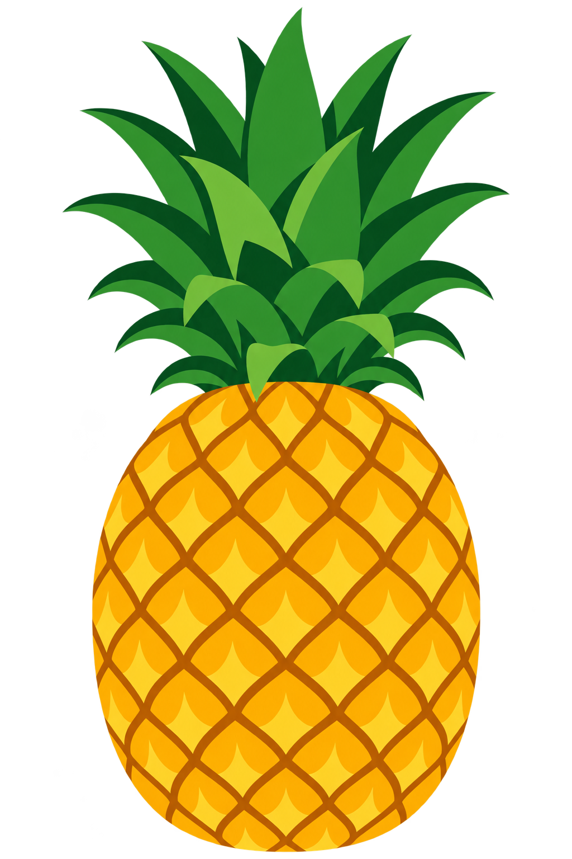
Pineapple
Latin name: Ananas comosus
Size: approximately 30 cm
Weight: 900–1,100 g
Pineapple icon supplied as an editable picture object.
Notes:
Supplied exercise facts: https://learning.noroff.no/mod/book/view.php?id=22907&chapterid=81645. Preserve the given botanical wording; it is not an independent taxonomy claim. Apply Facet and Dark Green, Accent 2, Darker 50% title colour. Apply Morph to all slides. This scaffold has no actual media, animations or theme applied. Required object effect: Fade. Banana background removal and pineapple sizing require native editing.
Media added: pineapple-icon.png. Generated educational asset. This is a raster icon picture. If native SVG icon editing is required, replace through Insert → Icons.

Slide 5
Annual fruit consumption
Fruit | kg
Lemon | 2.5
Banana | 12
Pineapple | 3.5
Supplied exercise values; population and year unspecified.
Notes:
Editable table and bar chart use identical supplied values 2.5,12,3.5 kg. Embedded chart workbook is a literal snapshot, not a linked source. No population, denominator or reporting year supplied. Source: https://learning.noroff.no/mod/book/view.php?id=22907&chapterid=81645.

